Slide 1
Introduction to NLP

Slide 2
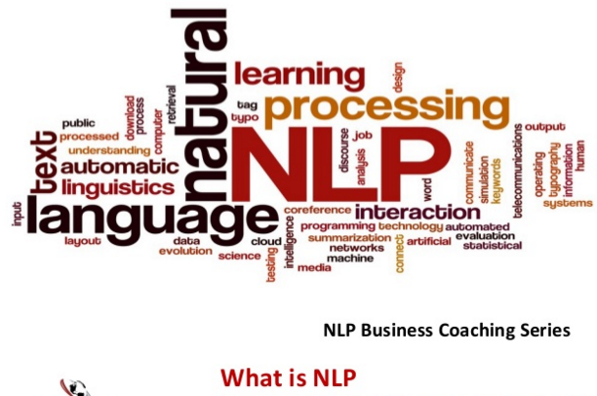

Slide 3
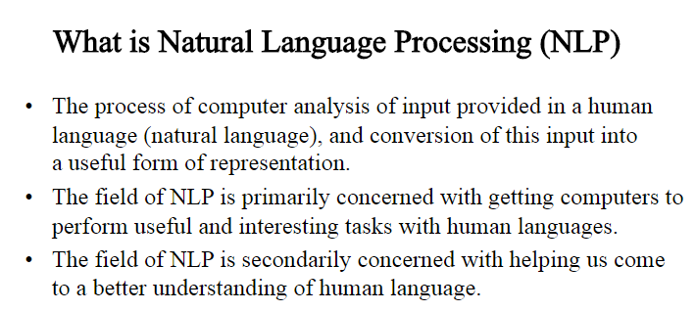
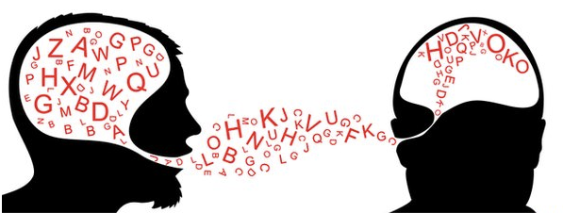

Slide 4
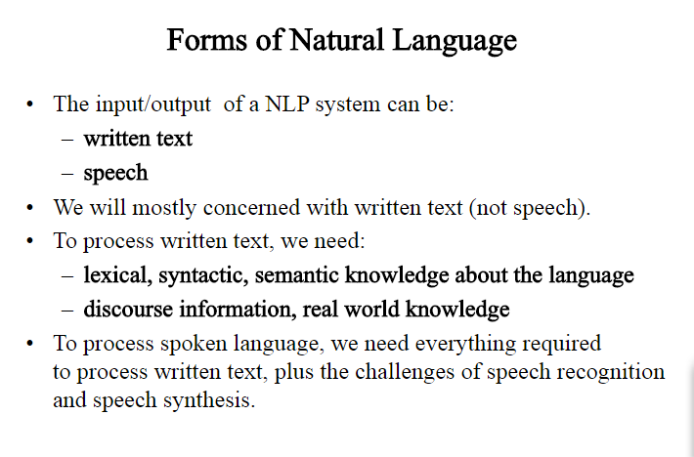

Slide 5
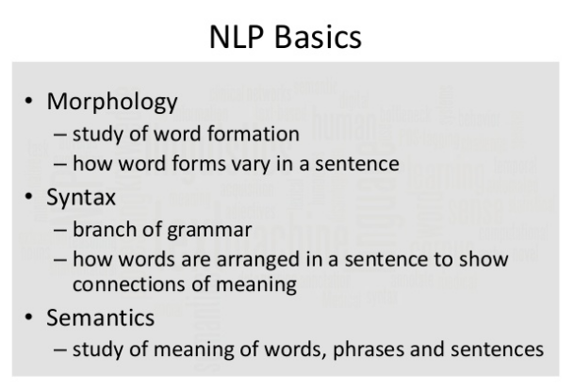

Slide 6
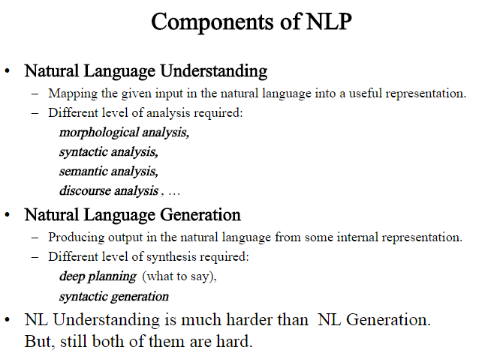

Slide 7
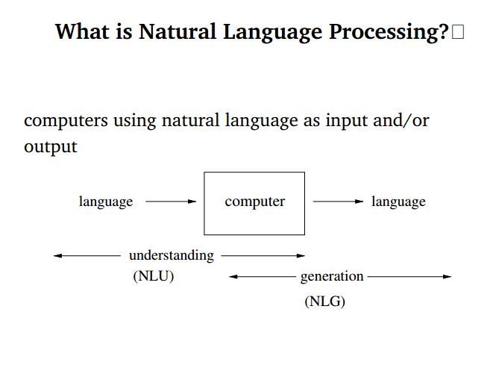
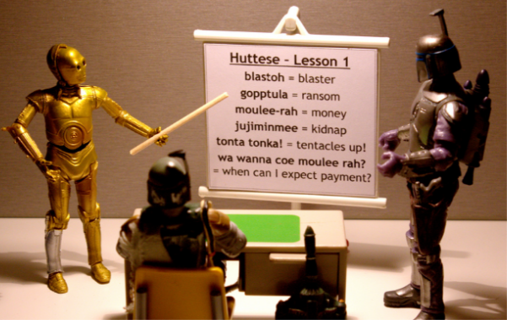

Slide 8
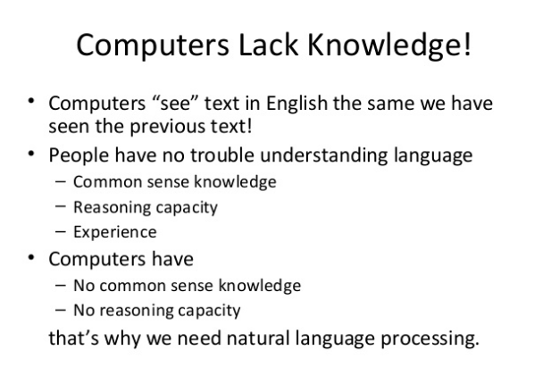

Slide 9
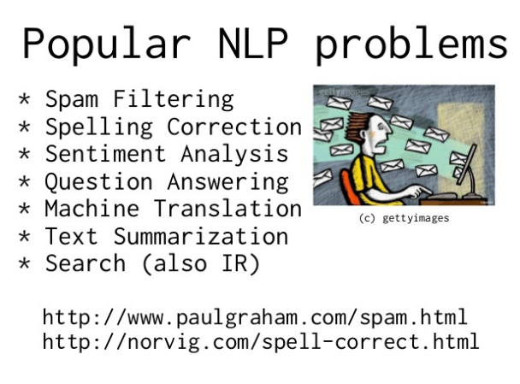

Slide 10
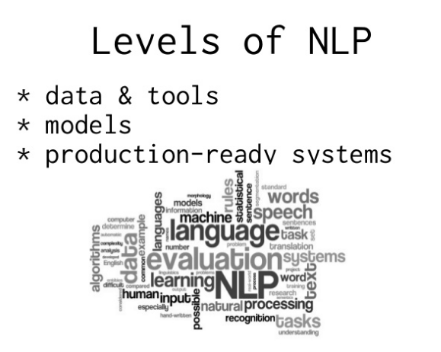

Slide 11
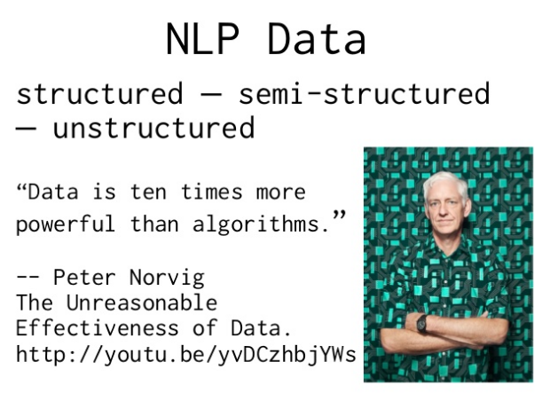

Slide 12

What will we do in this course?
Learn how to process Raw Text
Extract Information from Text
Learn how to Classify Text
Search by most similar words/documents
Analyze Sentence Structure

Slide 13
Text sources

Slide 14
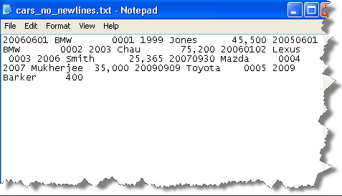
Where can text data come from?
Local files.
Electronic books.
HTML documents.
NLTK Collections.
API’s (Tweeter,
Wikipedia, Arxiv etc.)

Slide 15


Read local files
>>> f = open('document.txt')
>>> raw = f.read()
>>> import csv >>> with open('eggs.csv', 'rb') as csvfile: ... spamreader = csv.reader(csvfile, delimiter=' ', quotechar='|') ... for row in spamreader: ... print ', '.join(row)

Slide 16

Read local files
>>> import pyPdf
>>> pdf = pyPdf.PdfFileReader(open(filename, "rb"))
>>> for page in pdf.pages:
… print page.extractText()

Slide 17
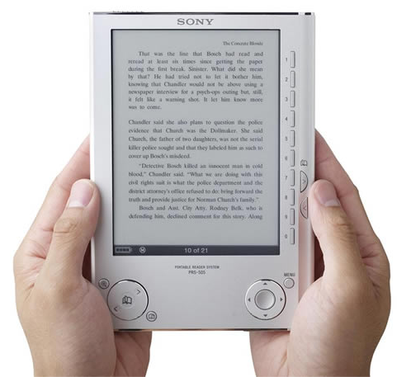
Electronic books reading
>>> from urllib import urlopen
>>> url = "http://www.gutenberg.org/files/2554/2554.txt"
>>> raw = urlopen(url).read()
>>> type(raw)
<type 'str'>
>>> len(raw)
1176831
>>> raw[:75]
'The Project Gutenberg EBook of Crime and Punishment, by Fyodor Dostoevsky\r\n'

Slide 18
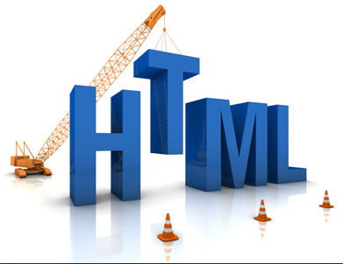
HTML documents reading
>>> from urllib import urlopen
>>> url = "http://news.bbc.co.uk/2/hi/health/2284783.stm"
>>> html = urlopen(url).read()
>>> html[:60]
'<!doctype html public "-//W3C//DTD HTML 4.0 Transitional//EN'
>>> import nltk
>>> raw = nltk.clean_html(html)
>>> tokens = nltk.word_tokenize(raw)
>>> tokens
['BBC', 'NEWS', '|', 'Health', '|', 'Blondes', "'", 'to', 'die', 'out', ...]

Slide 19
NLTK library
NLTK is a leading platform for building Python programs to work with human language data.
>>> import nltk
NLTK is open-sourse project.

Slide 20

NLTK books importing
>>> from nltk.book import *
>>> text1
<Text: Moby Dick by Herman Melville 1851>
>>> text2
<Text: Sense and Sensibility by Jane Austen 1811>
>>> text3
<Text:The Book of Genesis>
>>> text4
<Text: Inaugural Address Corpus>

Slide 21
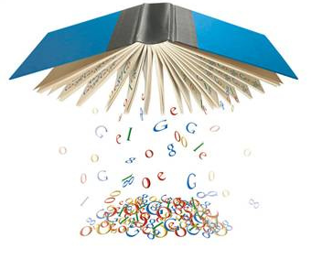
NLTK text corpora
A text corpus in NLTK is a large body of text.
Many corpora are designed to contain a careful balance of material in one or more genres.
>>> import nltk
>>> from nltk.corpus import ...

Slide 22
Gutenberg Corpus
a small selection of texts from the Project Gutenberg electronic text archive, which contains some 25,000 free electronic books, hosted at http://www.gutenberg.org/.
>>> from nltk.corpus import gutenberg
>>> gutenberg.fileids()
['austen-emma.txt', 'austen-persuasion.txt', 'austen-sense.txt', ...]
>>> emma = gutenberg.words('austen-emma.txt')
>>> len(emma)
192427

Slide 23

Web and Chat Text
a small collection of web text includes content from a Firefox discussion forum, conversations overheard in New York, the movie script of Pirates of the Carribean, personal advertisements, and wine reviews.
>>> from nltk.corpus import webtext
>>> for fileid in webtext.fileids():
... print fileid, webtext.raw(fileid)[:65], '...'
firefox.txt Cookie Manager: "Don't allow sites that set removed cookies to se...
grail.txt SCENE 1: [wind] [clop clop clop] KING ARTHUR: Whoa there! [clop...
overheard.txt White guy: So, do you have any plans for this evening? Asian girl...
pirates.txt PIRATES OF THE CARRIBEAN: DEAD MAN'S CHEST, by Ted Elliott & Terr...
singles.txt 25 SEXY MALE, seeks attrac older single lady, for discreet encoun...
wine.txt Lovely delicate, fragrant Rhone wine. Polished leather and strawb...

Slide 24
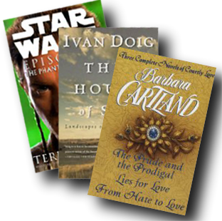
Brown Corpus
contains text from 500 sources, and the sources
have been categorized by genre, such as news, editorial, and so on.
>>> from nltk.corpus import brown
>>> brown.categories()
['adventure', 'belles_lettres', 'editorial', 'fiction', 'government', 'hobbies', 'humor', 'learned', 'lore', 'mystery', 'news', 'religion', 'reviews', 'romance', 'science_fiction']
>>> brown.words(categories='news')
['The', 'Fulton', 'County', 'Grand', 'Jury', 'said', ...]
>>> brown.sents(categories=['news', 'editorial', 'reviews'])
[['The', 'Fulton', 'County'...], ['The', 'jury', 'further'...], ...]

Slide 25
Reuters Corpus
contains 10,788 news documents totaling 1.3 million words. The
documents have been classified into 90 topics.
>>> from nltk.corpus import reuters
>>> reuters.fileids()
['test/14826', 'test/14828', 'test/14829', 'test/14832', ...]
>>> reuters.categories()
['acq', 'alum', 'barley', 'bop', 'carcass', 'castor-oil', 'cocoa', 'coconut', 'coconut-oil', 'coffee', 'copper', 'copra-cake', 'corn', 'cotton', 'cotton-oil', 'cpi', 'cpu', 'crude', 'dfl', 'dlr', ...]
>>> reuters.words(categories='barley')[:14]
['FRENCH', 'FREE', 'MARKET', 'CEREAL', 'EXPORT', 'BIDS',
'DETAILED', 'French', 'operators', 'have', 'requested', 'licences', 'to', 'export']

Slide 26
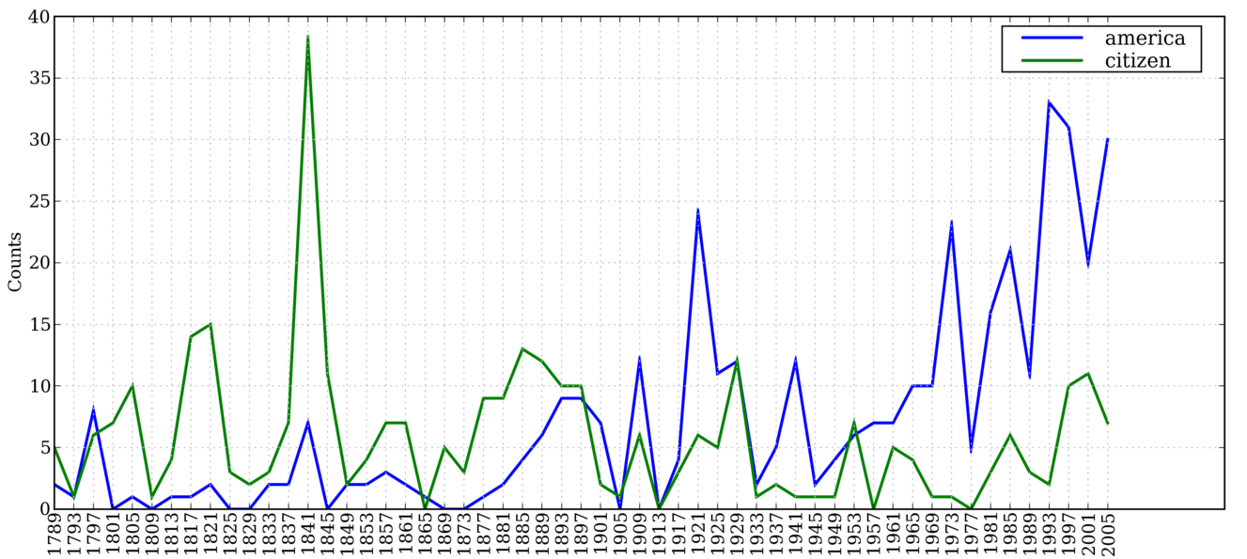
Inaugural Address Corpus
is actually a collection of 55 texts, one for each presidential address
>>> from nltk.corpus import inaugural
>>> inaugural.fileids()
['1789-Washington.txt', '1793-Washington.txt', '1797-Adams.txt', ...]
>>> [fileid[:4] for fileid in inaugural.fileids()]
['1789', '1793', '1797', '1801',
'1805', '1809', '1813', '1817',
'1821', ...]

Slide 27
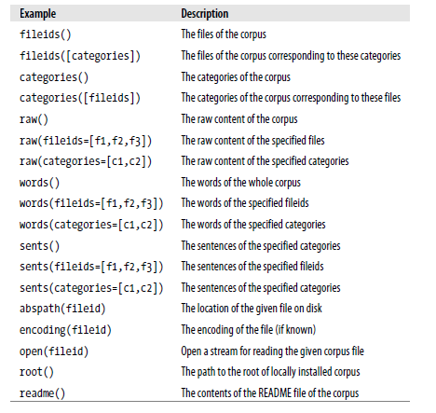
Structure of corpus
>>> raw = gutenberg.raw("burgess-busterbrown.txt")
>>> raw[1:20]
'The Adventures of B'
>>> words = gutenberg.words("burgess-busterbrown.txt")
>>> words[1:20]
['The', 'Adventures', 'of', 'Buster', 'Bear', 'by', 'Thornton', 'W', '.', 'Burgess', '1920', ']', 'I', 'BUSTER', 'BEAR', 'GOES', 'FISHING', 'Buster','Bear']
>>> sents = gutenberg.sents("burgess-busterbrown.txt")
>>> sents[1:20]
[['I'], ['BUSTER', 'BEAR', 'GOES', 'FISHING'], ['Buster', 'Bear', 'yawned', 'as',
'he', 'lay', 'on', 'his', 'comfortable', 'bed', 'of', 'leaves', 'and', 'watched',
'the', 'first', 'early', 'morning', 'sunbeams', 'creeping', 'through', ...], ...]

Slide 28
Thank you!

